Slide 1
Casting Techniques
presenter: samuel mutisya
orthopaedic and trauma

Slide 2
Objectives
Introduction to casting and splinting
Overview of materials and their properties
Occupational health and safety

Slide 3
Upper limb casts and splints
Lower limb casts and splints
Other body casts and splints

Slide 4
Introduction
Casts and splints are hard wraps used to support and protect injured bones, ligaments, tendons, and other tissues.

Slide 5
…Intro
They help fractures heal by keeping
the fragments ends together and as
straight as possible.
Casts and splints also help with
pain and swelling and protect the
injured area from more harm.

Slide 6
Definition
Cast - method of temporary immobilization
that circumferentially incorporates
a part or parts of a body.
They provide superior immobilization
Less forgiving- higher complication rates

Slide 7
Generally reserved for more complex
and definitive # management
Continuous immobilization can lead to chronic pain, joint stiffness, muscle atrophy and
complex regional pain syndrome

Slide 8
….definition
Splint- a method of temporarily immobilizing body parts non-circumferentially
Used before definitive treatment

Slide 9
When there is oedema
Vascular compromise
Initial stabilization
Prevention of further damage to soft tissues

Slide 10
Occupational health n safety
Patient is advised (instructions to the patient)
Review
Duration
Specific casts
Storage and waste disposal

Slide 11
Chemistry of plaster of paris
Plaster of Paris is derived from naturally occurring mineral gypsum. The chemical formula for gypsum is caso4- 2H2O.
The name “Plaster Of Paris” reflects the extensive deposits of gypsum found in the Paris basin in France and more specifically the Montmartre district.
Gypsum is converted into Plaster Of Paris by pulverization and subsequent calcinations. Calcinations transform the crystalline gypsum to an amorphous state and require high temperatures to release water. The reaction is exothermic and is described by the following chemical equation.
2 (caso4-2H2O) changes (CaSo4).H2o + 3H20
Gypsum P.O.P water

Slide 12
….chemistry of plaster of paris
The chemical reactions are reversible. When water is added to calcinated gypsum or Plaster of Paris, crystalline gypsum reforms with the release of heat.
This exothermic reaction explains the warmth associated with cast setting,
the amount of heat given off by the cast depends on the amount of plaster used and the temperature of the immersion water.

Slide 13
Summary
Plaster of Plaster (what it is)
Gypsum=also calcium sulphate
The basic mineral gypsum in rock form is grounded to a fine powder.
This is heated to drive out three-quarters of its intrinsic water content to become Plaster Of Paris.
The Powder is then mixed with cellulose and chemical solvents in this liquid state- it is impregnated by a heating process on the linear cloth.
NB It is open woven, interlocked fabric which holds the Plaster uniformly and provides additional strength when the compound is applied to produce gypsona in bandages and slabs.

Slide 14
….summary
Setting time: time taken to change from powder form to crystalline form.
Drying time: time taken to change from crystalline form to anhydrous form.
Average setting time: 3 – 9 minutes.
Average drying time: 24 – 72 hours.

Slide 16
Faster setting of cast
Hot water
Salt
Borax
Resin

Slide 17
Factors lengthening setting time
Cold water
Sugar

Slide 18
Pop complications
Due to tight fit
Pain
Pressure sore
Compartmental syndrome
Peripheral nerve injury
Impaired bld circulation

Slide 19
……..Complication
Due to improper aplication
Joint stiffness
Blisters and sores
breakage
Due to plaster allergy
Allergic dermatitis

Slide 20
Types of casting material
Plaster of Paris bandage (pop)
Synthetic fibers (more expensive than pop)
Clay soil (used before introduction of pop)
Cured hide and skin (ancient )
Duckworth(4th edition)

Slide 21
Pop physical properties
Comparatively lighter than clay
Disintegrates when socked in water
Hardens enough after 24 hours
Innocuous (harmless) to the body skin
It soaks rapidly

Slide 22
….Properties
It is porous in nature
Becomes smooth when molded
It is creamy in nature
It is soft

Slide 23
General classification
Powder form
Bandage form (powder impregnated in gauze)

Slide 24
OVERVIEW OF CASTING & SPLINTING MATERIALS
Synthetic Material
Alternative splinting
Plaster of Paris
Fiberglass
Polyester
Dynacast
Dynacast

Slide 25
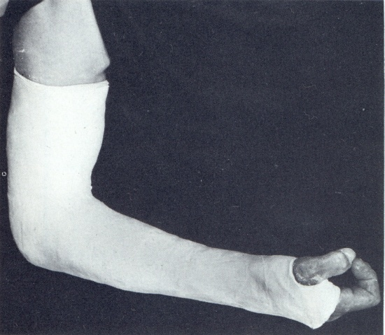
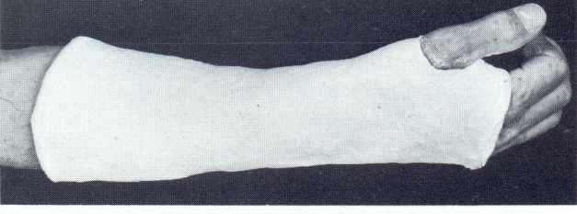
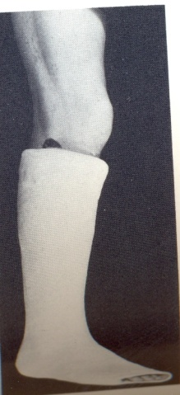
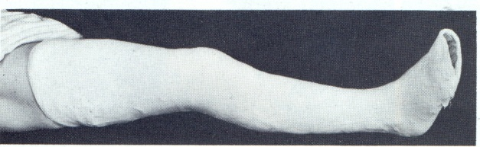
Pop cast
A/E

Slide 26
Cervical spine
Cervical collar – soft & hard
Minerva jacket
Halo thoracic support

Slide 27
Serial casting
C.T.E.V –
Genu valgum – in children
Genu varus –
Genu re

